Slide 1


AGE 219: Iteration and
Program Loops
School of Engineering and Technology (SoET)
Dr. Kadeghe Fue, PhD, P.Eng (T)
AI & Robotics Specialist | Office: EPAL

Slide 2
Recap: Lecture 3 Logic
Yesterday, we learned how to make single decisions using comparison operators and IF/ELSE structures.

Slide 3

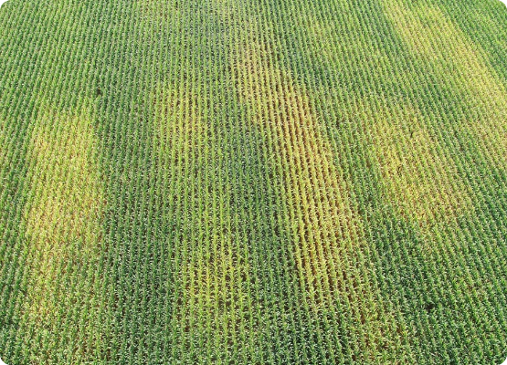
What is Iteration?
Efficiency through Repetition
In nature and engineering, tasks are often repeated. A field is planted row-by-row; sensors report data every minute.
Iteration allows a computer to run a block of code multiple times without rewriting it. This is the power of Automation.

Slide 4




Loop Types in Engineering
for Loop
while Loop
Definite Iteration: Used when you know exactly how many times to repeat (e.g., 50 plots).
Indefinite Iteration: Used when repeating until a condition changes (e.g., until the tank is full).

Slide 5
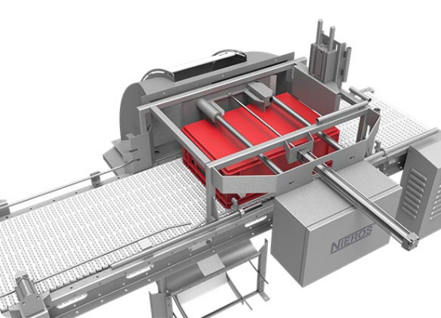
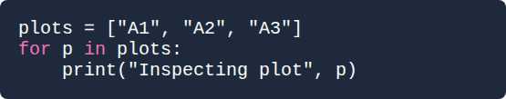
The for Loop in Practice
A for loop iterates over a sequence (like a list of plot IDs).
It moves through the items one by one until the list is exhausted.

Slide 6

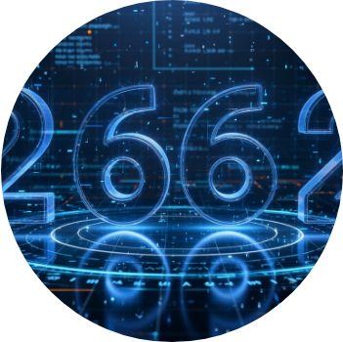
The range() Function
Generating Sequences
The range() function creates a series of numbers for loops:
•
range(5): 0, 1, 2, 3, 4
•
range(1, 6): 1, 2, 3, 4, 5
•
range(0, 10, 2): 0, 2, 4, 6, 8

Slide 7
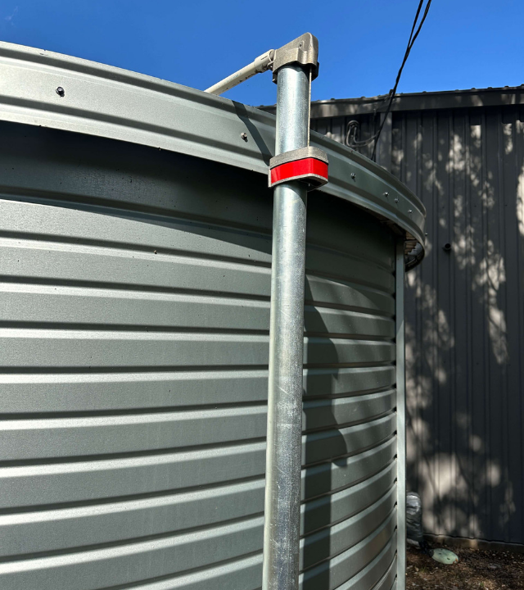
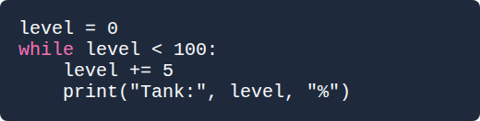
The while Loop
Monitoring Status
Used for continuous feedback loops where the endpoint isn't pre-defined.

Slide 8

Controlling Execution
break
continue
Immediately stops the loop. Essential for Emergency Stops in machinery control.
Skips the rest of the current turn and jumps to the next item (e.g., skip faulty sensors).

Slide 9
Data Aggregation
Using loops to process large datasets and calculate results.

Slide 10
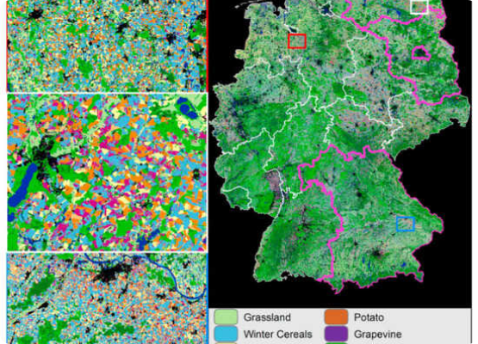
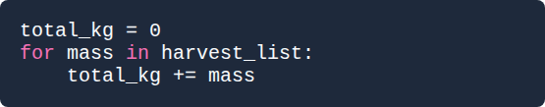
Accumulators and Counters
Calculating Totals
To sum a list of weights or rainfall, we use an Accumulator variable.
Remember to initialize total = 0 before the loop starts.

Slide 11


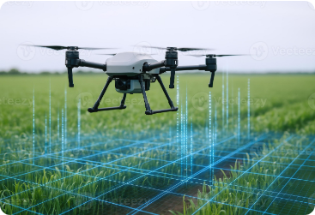


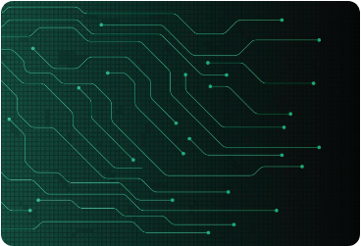


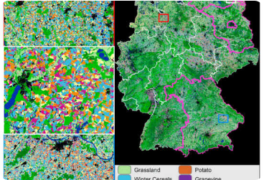
Nested Loops: Spatial Grids
Row Scan
Column Processing
Field Matrix

Slide 12
Efficiency of Automation
10k+
Computational Power
A human might take hours to check 1,000 sensor readings. A computer loop at SoET can process them in milliseconds.
Operations per Second
This allows for Real-Time adjustments in precision tractors.

Slide 13
Loop Best Practices
Avoid Infinite Loops: Always ensure the while condition eventually becomes False.
watch Indentation: All code inside the loop must be aligned (4 spaces).
Initialize Counters: Set sums and counters to zero before entering the loop.
Use range() wisely: Remember that range(10) stops at 9.

Slide 14

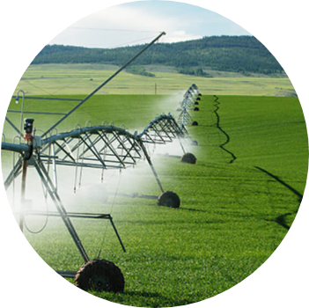
Case Study: Smart Irrigation
Autonomous Watering
Algorithm:
Check 24 moisture sensors.
IF sensor < 30%, turn on valve for plot X.
Wait 5 minutes.
Repeat cycle.

Slide 15


Questions?
Thank you for your attention.
Next Lecture: Functions and Modular Programming
School of Engineering and Technology (SoET) | SUA Morogoro

